Slide 1
Alternative and Natural treatments for Attention Deficit/Hyperactivity Disorder
Samir Deeb
University of Texas at San Antonio

Slide 2
Background
Natural alternatives to prescribed medication for treatment of ADHD
Specific changes in diet plan shown to succeed
Medical advances in the past involving ADHD have focused heavily on prescription medicine.
More recent studies show that simple changes in one’s diet plan can help tremendously with symptoms of ADHD
There is a growing problem among teens and young adults abusing this medication without a prescription, proving the need for natural alternatives

Slide 3
Research Questions
What can we do to prevent future harm to the teens and young adults using this medication?
How can we stop the growing global spread of ADHD medication?

Slide 4
Overview of Research
I believe through implementation of natural remedies for ADHD, the problems caused by prescription medication like Adderall and Ritalin can be stopped.
In order to achieve this, one must first be aware of what natural alternatives would work best for them. Everybody is different and reacts differently to these methods of improvement.

Slide 5
Research Design and Methods
My research was consisted mainly of scholarly journal articles written by various professionals in the field of medicine.
I also utilized information from the CDC including graphs and figures.
Information from surveys conducted through GSS were also utilized throughout my research

Slide 6
Results
Through my research I have found that there are in fact natural alternatives for treating ADHD, but the popularity of prescription medication like Adderall and Ritalin is still very high.
People must understand that a simple diet plan change can alleviate the symptoms of ADHD in our children and improve their performance in school and at home.
One must run tests to fully understand what may need to change
By knowing what allergies a child has, vitamin or nutritional deficiencies, and whether or not they have a sugar intolerance, one can prevent the need for prescription medication

Slide 7
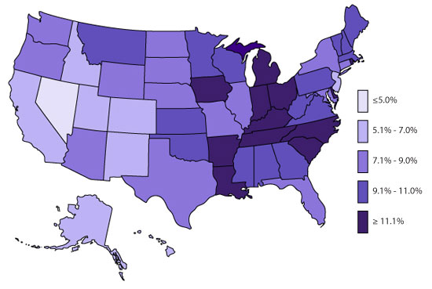
Percent of Youth Aged 4-17 with Current Attention-Deficit/Hyperactivity Disorder by State: National Survey of Children's Health

Slide 8
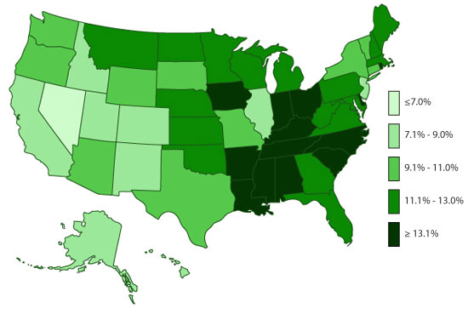
Percent of Youth 4-17 Ever Diagnosed with Attention-Deficit/Hyperactivity Disorder by State: National Survey of Children's Health

Slide 9
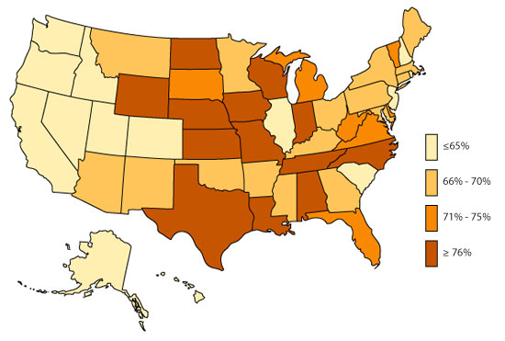
Percent of Youth Aged 4-17 Currently with ADHD Receiving Medication Treatment by State: National Survey of Children's Health

Slide 10
By promoting natural alternatives and providing people with ways to get tests done and fully understand what their body needs, we can stop the globalization of ADHD prescription medication while maintaining our children‘s health.

Slide 11
Conclusion
Through unique diet plans, depending on the patients needs, we can improve the behavior of children with ADHD at school and at home. Studies have shown that through these diet plans, grads have also improved tremendously.
These natural methods will also improve our children‘s health by excluding the highly addictive prescription medication on the market for ADHD treatment.

Slide 12
Next Steps
After finishing my research I found that there is much more work that needs to be done in order to change the publics mind on using natural methods of treatment in place of prescription medication
For future research to be conducted, the terrible side effects of these medications must be publicized. Our society places too much trust in our doctors, although they are professionals there are some who are in it for the money.

Slide 13
Works Cited
"ADHD Throughout the Years." Centers for Disease Control and Prevention. Centers for Disease Control and Prevention, 06 Oct. 2014. Web. 26 Apr. 2015.
"Data & Statistics." Centers for Disease Control and Prevention. Centers for Disease Control and Prevention, 10 Dec. 2014. Web. 26 Apr. 2015.
Dommisse, J.V. (2000) “Nutritional and Other Natural Medical Treatments for Attention-Deficit/Hyperactivity Disorder – AD(H)D”, Social Science Information 39(3): 489-504.
Fitzgerald, K. T., & Bronstein, A. C. (2013). Adderall? (amphetamine-dextroamphetamine) toxicity. Topics in Companion Animal Medicine, 28(1), 2-7. doi:http://dx.doi.org/10.1053/j.tcam.2013.03.002
Moore, S. C.,PhD.M.S.N.R.N. (2014, 10). Adderall and ritalin: Potential influence on perinatal health. International Journal of Childbirth Education, 29, 72-78. Retrieved from http://search.proquest.com/docview/1609199213?accountid=7122
Peter Conrad, Meredith R. Bergey, The impending globalization of ADHD: Notes on the expansion and growth of a medicalized disorder, Social Science & Medicine, Volume 122, December 2014, Pages 31-43, ISSN 0277-9536, http://dx.doi.org/10.1016/j.socscimed.2014.10.019.

